Slide 1
Module 8: MILEStone
PiNJU Chen
Colorado State University Global
MIS581: Capstone: Business Intelligence and Data Analytics
Dr. Orenthio Goodwin
01/15/2023

Slide 2

Introduction
The dual nature of real estate.
From early 2020 to late 2022, the nation's median home price ballooned by over 41% in US (Economist).
The dataset from the residential real estate website in Ames, Iowa.
Build the model to predict the housing price.
Notes:
We chose real estate industry as our target has two reasons. First, due to the dual nature of real estate, on the one hand, real estate is a necessity of life and one of the basic needs of people. On the other hand, real estate is often used as an investment target.
Second, in the United States, real estate has experienced rapid growth and recession in two years, from explosive growth during the COVID-19 period to the continuous decline in late-2022.
During the pandemic housing frenzy from early 2020 to late 2022, the nation's median home price ballooned by over 41%, Even as mortgage rates in recent weeks have ticked down slightly, economists are expecting higher rates to continue to dampen sales throughout 2023.
We think a reasonable estimate of housing prices has become more important. We found the dataset which includes 82 variables and housing prices in Ames, Iowa from the residential real estate website. we must use statistical analysis to find important factors that have a potential impact on prices, and build a model to predict housing prices in the area. we will use the multiple linear regression model to find the relationship between variables and housing price, if there is a significant relationship between them, this means that these variables have a large impact on house prices.

Slide 3
LITERATURE REVIEW
In Phipps, A. G., & Li, D’s study, they compared the hybrid price model from Quigley with the repeat sales model and the single sales hedonic model.
Paper-”Prediction and Analysis of Housing Price Based on the Generalized Linear Regression Model”.
Study-” The Choice of Functional Form and Variables in the Hedonic Price Model in Seoul”
Notes:
To evaluate the effect of these three models, the authors use observations' 70 variables that were analyzed within the executable limits of a linear regression procedure in Excel, to predict the prices of 1,275 sold and 1,284 resold homes observed in two inner-city neighborhoods in Windsor, Ontario, during a 30-year period. Through this paper comparing the correctness of various models for price prediction, we know that the goodness of fits obtained under different conditions is different. And multiple linear regression is a good method for price prediction and it statistically explains more of the variation in the house price dependent variable.
The other paper using a linear regression model to build a real estate price prediction model. In this paper, The authors think the multiple regression model only considers the variables that affect housing prices. But there have some factors that are nonparametric but also affect the housing price, failure to account for these variables can lead to a decrease in the accuracy of the model.
The hedonic price model is one of the popular models to predict the housing markets, the study” The Choice of Functional Form and Variables in the Hedonic Price Model in Seoul” tries to prove the applicability of the hedonic price model in different countries and housing markets. According to this article, we know that the characteristic price structure of the real estate market in each region is different. Like in my research object Ames, Iowa, there may be some factors that affect the proportion of housing prices higher than others, so we must consider the region and cultural background, and then adjust.

Slide 4
Research Questions
Q1: Housing prices are affected by lot size, type of dwelling, remodel date, type of foundation, number of kitchens.
Q2: If the bid is less than $170,000, the buyer can buy a house built before 2000.
Q3: The most popular total rooms and the number of bedrooms in this area are 5 and 2 respectively.
Q4: June is the hottest time of year for house sales in Ames, Iowa.
Notes:
Q1: Housing prices are affected by lot size, type of dwelling, remodel date, type of foundation, number of kitchens.
Null hypothesis (H0): The top five variables that affect house prices the most are not lot size in square feet (LotArea), type of dwelling (BldgType), remodel date (YearRemodAdd), type of foundation (Foundation), number of kitchens (Kitchen).
Alternate hypothesis (Ha): The top five variables that affect house prices the most are lot size in square feet (LotArea), type of dwelling (BldgType), remodel date (YearRemodAdd), type of foundation (Foundation), number of kitchens (Kitchen).
Q2: If the bid is less than $170,000, the buyer can buy a house built before 2000.
Null hypothesis (H0): If the bid is less than $170,000, the buyer can not buy a house built before 2000.
Alternate hypothesis (Ha): If the bid is less than $170,000, the buyer can buy a house built before 2000.
Q3: The most popular total rooms and the number of bedrooms in this area are 5 and 2 respectively.
Null hypothesis (H0): The most popular total rooms (TotRmsAbvGrd) and Number of bedrooms (Bedroom) in this area are not 5 and 2.
Alternate hypothesis (Ha): The most popular total rooms (TotRmsAbvGrd) and Number of bedrooms (Bedroom) in this area are 5 and 2 respectively.
Q4: June is the hottest time of year for house sales in Ames, Iowa.
Null hypothesis (H0): June is not the hottest time of year for house sales in Ames, Iowa.
Alternate hypothesis (Ha): June is the hottest time of year for house sales in Ames, Iowa.

Slide 5
Methods
Q1: Multiple regression model can be used to check the relationship between variables.
Formula in our model is Y= 𝛽0+ 𝛽1X+ 𝛽2X+𝛽3X+...+𝛽82X+ε.
Q2: Use logistic regression model can help us predict the probability corresponding to an event that has two outcomes is the logistic regression model.
Q3: By write the code on SAS. Analyzing the combination of the number of bedrooms and total rooms in this area can be used as a reference for future house construction.
Q4: By write the code on SAS. The hot time of sale is a very important factor in real estate sales
Notes:
Q1: The multiple linear regression model is the best method to help us predict housing prices. Use multiple regression to find the value that best calculates the specific data for which they are searching. This data can help predict the factors that result in an outcome or forecast an effect or trend (Sheposh, 2020). The multiple linear regression model formula in our model is Y= 𝛽0+ 𝛽1X+ 𝛽2X+𝛽3X+...+𝛽82X+ε. Then R-squared can be used to check the linear regression performance. If R-squared=0, then it is a very poor fit for the data. If R-squared =1 indicates the line is a perfect fit.
Q2: The statistical test that can be used to predict the probability corresponding to an event that has two outcomes is the logistic regression model. Logistic regression also referred to as the logit model, is used to model dichotomous outcome variables. In a logit model, the log odds of the outcome are modeled as a linear combination of the predictor variables.
After Finding the important predictors, we can use them to verify the correctness of the model and find the individual odds of the two outcomes. The probability of success is related to the independent variable X, which is the year the house was built. In the logistic regression model, Y is a binary variable (yes or no, exist or not exist), and Y in our model is the house sales amount 170,000. If the result is greater than or equal to 0, then it is one type; otherwise, it is another type. If the Alternate hypothesis is true, we can predict whether houses built after 2000(original construction date) can be purchased for 170,000 dollars.
Q3: Analyzing the combination of the number of bedrooms(variable Bedroom) and total rooms (TotRmsAbvGrd) in this area can be used as a reference for future house construction, and it can also let sellers who want to sell their houses know whether their houses are popular in the market. This also uses a linear regression model to calculate the influence of variables and to visualize the results.
Q4: The hot time of sale is a very important factor in real estate sales. It is generally believed that July and August are the hottest months for sales. Through data analysis, we can understand which month is the hottest month of the year for sales in Ames, Iowa. Then which year is the time when most homes are sold, those can give sellers a reference for when is the best time to sell a home.

Slide 6
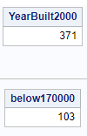
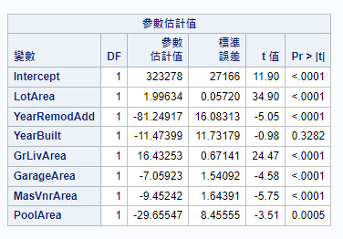
Result- Q1&Q2
Q1-Sale price = 323,278+1.99*Lot Area-81.25*YearRemodAdd-11.47*YearBuilt+16.43GrLivArea-7.05*MasVnrArea-9.45x6-29.65*Pool Area + ε.
Q2- 371 houses built after 2000 and 103 of them are under 170,000. The buyer still has 27.7% probability to buy a house built after 2000.
Notes:
The P-values in variable LotArea, YearRemodAdd, GrLivArea, MasVnrArea, and GarageArea are all <0.001 which is significant. The P-values in YearBuilt and PoolArea are not <0.001 which does not significantly affect the Y(sale price). R-squared in our model = 0.6584 which means there has 65% of the data can be explained by our model. It can be seen that there is a positive correlation between the variable with the Y(sale price). The price rises when LotArea increases and Remodel date is closer to the present.
In order to analyze this problem, we wrote code in SAS. There are 1,459 houses in the dataset, 371 houses built after 2000 and 103 of them are under 170,000. So we can accept the alternate hypothesis (Ha) that if the bid is less than $170,000, the buyer still has 27.7% probability to buy a house built after 2000.

Slide 7
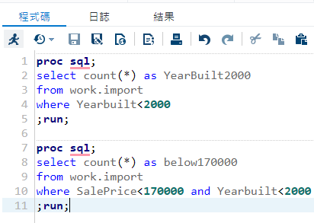

Code in Q1 & Q2

Slide 8
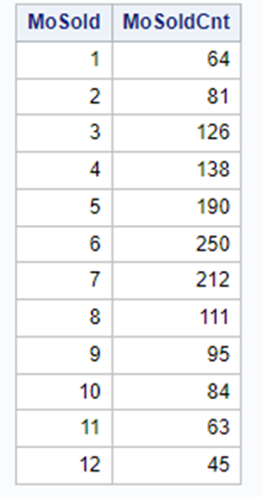
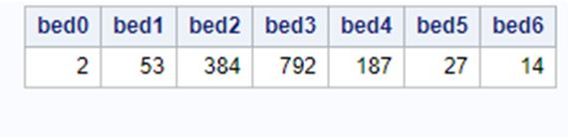

Result- Q3&Q4
Q3-The most popular number of rooms is 6, and the most popular number of bedrooms is 3.
Q4- June is the most popular month to sell a house in Ames, Iowa.
Notes:
By listing all category’s quantities, the most popular total room number is 6 rooms not including bedrooms, the most popular number of bedrooms is 3 bathrooms. So we reject the Alternate hypothesis (Ha).
To analyze this problem, we wrote code in SAS. The hottest time of year for house sales in Ames, Iowa is June. May and July are also very hot for sales. We can accept the Ha and suggest to any customer who wants to sell their house in Ames, Iowa, summer is the best time.

Slide 9
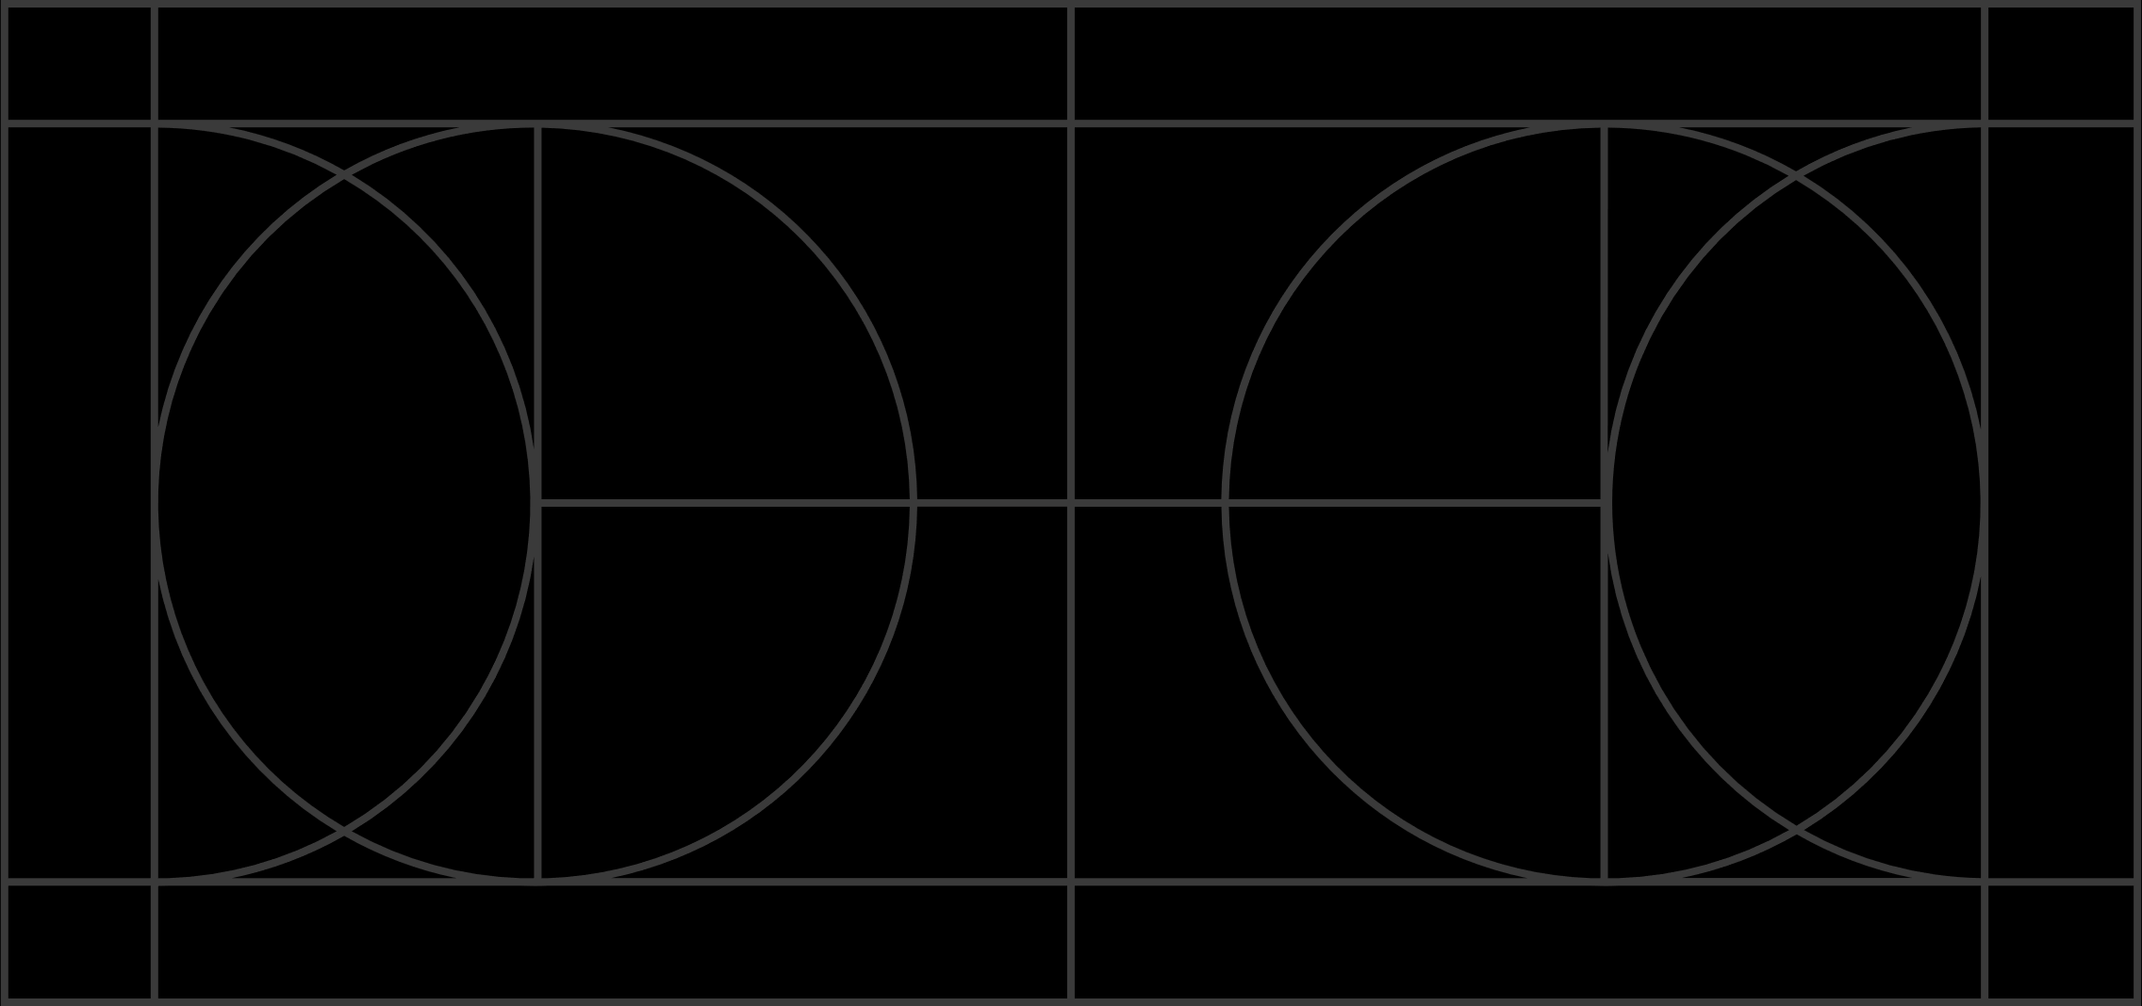
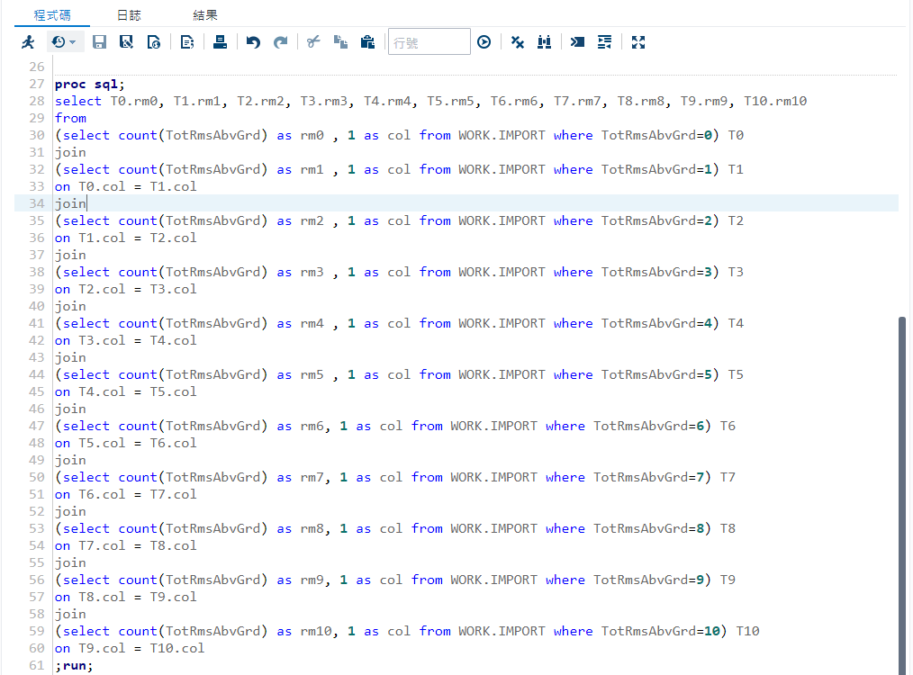
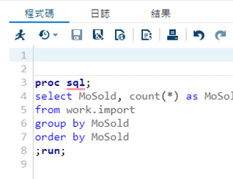
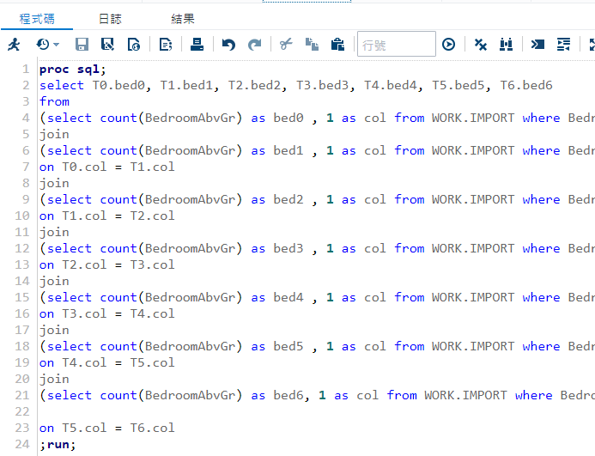
Code in Q3 & Q4

Slide 10
Research Limits & Ethical Considerations
No single study can cover all possible angles.
House information are open source, but we still need to avoid illegal use of personal data.
Notes:
Our research provides a direction for real estate price research, but the variables affected by real estate prices in different regions will be different. This model is suitable for Ames, Iowa, but not necessarily applicable to all of the world, and also maybe not necessarily applicable to all of America. This time there are 82 sample variables and 1,459 samples, but I think a larger sample size is needed to ensure fair representation.
Unlike the medical industry or the banking industry, which require confidentiality of customer information, real estate information is publicly available on the Internet for everyone to check, such as transaction date, construction date, transaction price, location, interior decoration, etc. Information about the house itself can basically be found on various real estate websites. But we still need to avoid violations of IT ethics such as illegal use of personal data, license infringement, and exposure of individual house addresses and private information on the Internet during the research process.。

Slide 11
Conclusions
We use the residential real estate dataset in Ames, Iowa to build a regression model.
Our model can provide some pricing advice and future predictions.
Notes:
In the real estate industry, every buyer wants to buy their dream house at the lowest price, and every seller wants to sell their house at the highest price as quickly as possible. But no one can know the right price for that house. We use the housing prices dataset in Ames, Iowa to find the best model to predict the housing price. Based on the model we build, it doesn’t matter whether you are buyers, sellers, architects, planners, or real estate managers, you can get price-setting advice in this area that can be found through this research.

Slide 12
Reference
Thomas Barrabi. (2022). Economist explains why the ‘floor is coming’ for US housing market. New york post. Retrived from https://nypost.com/2022/11/17/why-the-floor-is-coming-for-us-housing-market-economist/?utm_source=url_sitebuttons&utm_medium=site%20buttons&utm_campaign=site%20buttons
Phipps, A. G., & Li, D. (2019). Calibration and evaluation of Quigley’s hybrid housing price model in Microsoft Excel. PloS One, 14(4), e0215954. https://doi.org/10.1371/journal.pone.0215954
Li, X. (2022). Prediction and Analysis of Housing Price Based on the Generalized Linear Regression Model. Computational Intelligence and Neuroscience, 2022, 3590224. https://doi.org/10.1155/2022/3590224
Huh, S., & Kwak, S.-J. (1997). The Choice of Functional Form and Variables in the Hedonic Price Model in Seoul. Urban Studies, 34(7), 989–998.
Sheposh, R. (2020). Multiple regression. Salem Press Encyclopedia.

